Slide 1

Faithful Living. . . .Fearless Leading
Joshua 1

Slide 2


Slide 3
What do we know about Joshua?
Joshua means – Yahweh saves
Joshua was one of the twelve spies sent by Moses
to explore the land of Canaan. (Numbers 13)
A military strategist who will lead the people of Israel
under God’s command into the promise land.

Slide 4
Why study the book of Joshua?
The events of the book of Joshua span about twenty-five years, starting soon after the death of Moses (Joshua 1:1) around 1406 BC.
Joshua not only documents the high points of Israel's quest for the Promised Land but offers valuable leadership lessons applicable to anyone guiding their family, organization, church, or community.

Slide 5

Observations on Joshua 1:1-18
Asks the question: What do I see in the passage that stands out? Look for key words, phrases, comparisons or contrasts. Questions like – Who? What? Where? When? How? and Why?
Observation teaches us to see exactly what the passage says. It is the basis for accurate interpretation and correct application.

Slide 6
Observations on Joshua 1:1-18
What are some observations we can make about:
Joshua
God’s instructions to Joshua
The people of Israel

Slide 7
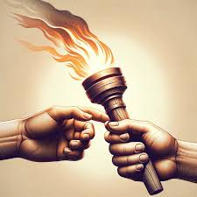
Observations on Joshua 1:1-18
A Transfer of Leadership and Responsibilities
God has selected Joshua as the new leader of
Israel after Moses death. “After the death of
Moses…”
Moses = 11 times (shows credibility)

Slide 8
Observations on Joshua 1:1-18
When selecting leaders:
-observe their character
-observe their abilities (their skill set, giftedness)
- are they available, faithful and teachable.
Ask…what kind of leaders am I looking for?
(Character)
What role or responsibility do I want them to fill?

Slide 9
Observations on Joshua 1:1-18
All of us experience an element of fear when stepping out.
Fear of things
Fear of failure
Fear of the unknown

Slide 10
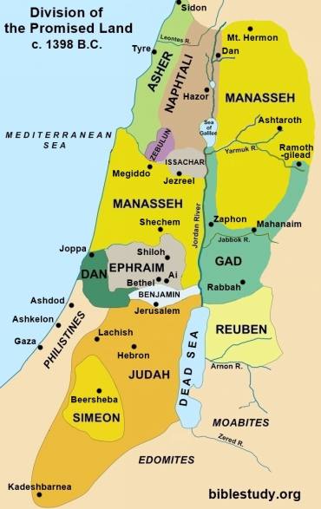
Longitude and Latitude
of Boundaries
Every place the sole of your feet
go, I will give it to you.
Joshua 1:3

Slide 11
God gives instructions and assurance to Joshua as he and the people of Israel move closer to the promise land.
What assurances does God give Joshua in……
Verse 2 & 4
Verse 3
Verse 5-9
What assurances does Joshua give to the leaders and
to the people of Israel in……..
Verses 11
Verse 13 & 15
What is the response of the people in verses 16-18?

Slide 12



Slide 13
How many times does the Lord say to Joshua to be Strong and Courageous?
Why do you think this is?
The strength and courage of the Lord will be evident in our life, when our focus is on the Lord and His Word, not our situation.

Slide 14
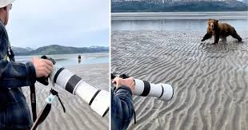

Slide 15
Leadership Principles from Joshua 1
A good leader doesn’t just talk about strength and courage; he demonstrates it to those around him.
It’s not proclaimed…its proven.
A good leader not only knows what his responsibility is, but he has others following his leadership and vision.

Slide 16
Leadership Principles from Joshua 1
Obedience follows obedience
People may follow your leadership because of your title, but you can be certain people will follow your leadership if you do what you say you will do.

Slide 17
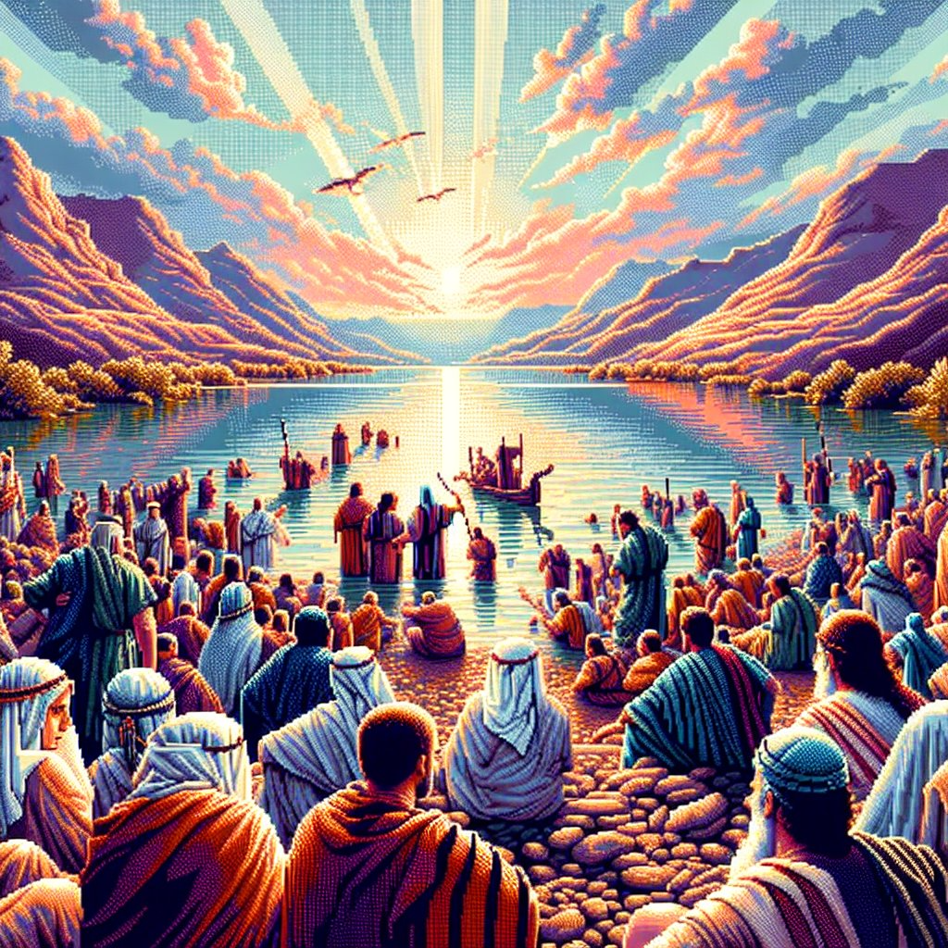
. . .the land that Moses the servant of the Lord gave you beyond the Jordan toward the sunrise.
Joshua 1:15

Slide 18
Sermon outline on Joshua 1
The transfer of leadership and responsibility to Joshua.
God’s instruction to Joshua.
God’s assurance to Joshua.
God’s people respond to Joshua.
.

Slide 19
La Bondad De Dios
Te amo Dios Tu amor nunca me falla Mi existir en Tus manos está Desde el momento en que despierto Hasta el anochecer Yo cantare de la bondad de Dios
En mi vida has sido bueno En mi vida has sido tan fiel Con mi ser, con cada aliento Yo cantare de la bondad de Dios
.

Slide 20
La Bondad De Dios
Yo amo Tu voz Me has guiado por el fuego Tu cerca estás en la oscuridad Te conozco como Padre Y como amigo fiel Mi vida está en la bondad de Dios
Tu fidelidad sigue persiguiéndome Tu fidelidad sigue persiguiéndome Todo lo que soy te lo entrego hoy A Ti me rendire Tu fidelidad sigue persiguiéndome
.

