Slide 1

Faithful Living…..Fearless Leading
Joshua 3:1-17
Crossing the River Jordan

Slide 3

Observations on Joshua 3:1-17
Asks the question: What do I see in the passage that stands out? Look for key words, phrases, comparisons or contrasts. Questions like – Who? What? Where? When? How? and Why?
Observation teaches us to see exactly what the passage says. It is the basis for accurate interpretation and correct application.

Slide 4
Observations
Repeated words:
River Jordan is recorded 11 times in this event.
Ark of the Covenant is recorded 10 times
Key Words or phrases:
Consecrate – 3:5
The water stood and rose up in a heap – 3:16
The town Adam – 3:16
Dry ground – 3:17

Slide 5
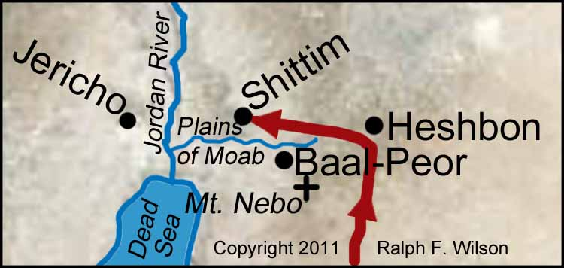
Distance from Shittim to Jordan River was 9 kilometers

Slide 6
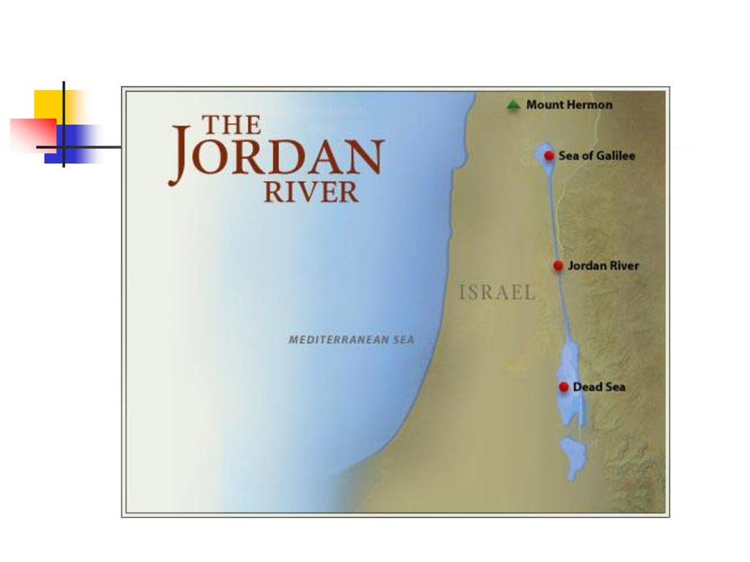
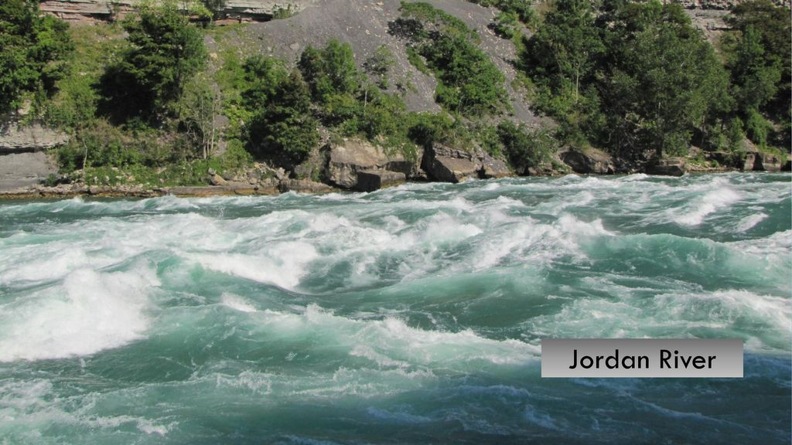

Slide 7
Consecrate yourselves for tomorrow the Lord will do wonders among you. Vs.5
What does “consecrate” mean?
Time lapse between verses 5 & 6.
Then Joshua told the people, “Purify yourselves, for tomorrow
the Lord will do great wonders among you.”
In the morning Joshua said to the priests, . . . .

Slide 8
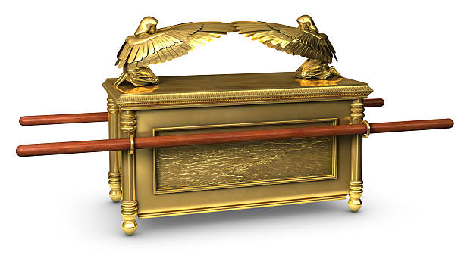
The Ark of the Covenant

Slide 9
Four Actions instructed by God for the people
Follow – verses 2-4
Consecrate – verse 5
Watch – verse 7-11
Stand – verse 8

Slide 10
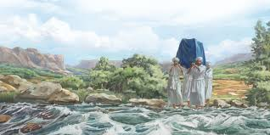

Slide 11
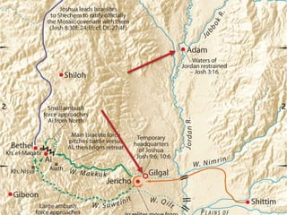
30 Kilometers from the town of Adam

Slide 12
Jordan River - Leadership Lessons
Lesson # 1 God is always working upstream!
Lesson # 2 Watch God, not your surroundings.

Slide 13
Jordan River - Leadership Lessons
Lesson # 3 Let go of what you can’t control.
Lesson # 4 When faced with your Jordan River crossing, dwell on the….
Power of God
Presence of God
Provision of God
Protection of God

Slide 14


Slide 15
Way Maker
Aquí estás, te vemos mover Te adoraré, te adoraré Aquí estás, obrando en mí Te adoraré, te adoraré Aquí estás, te vemos mover Te adoraré, te adoraré Aquí estás, obrando en mí Te adoraré, te adoraré

Slide 16
Way Maker
(Coro)
Milagroso, abres camino Cumples promesas, luz en tinieblas Mi Dios, así eres tú Milagroso, abres camino Cumples promesas, luz en tinieblas Mi Dios, así eres tú

Slide 17
Way Maker
Aquí estás, tocando mi corazón Te adoraré, te adoraré Aquí estás, sanando mi corazón Te adoraré, te adoraré

Slide 18
Way Maker
Aquí estás, sanando mi corazón Te adoraré, te adoraré Aquí estas, tocando mi corazón Te adoraré, te adoraré

