Slide 1

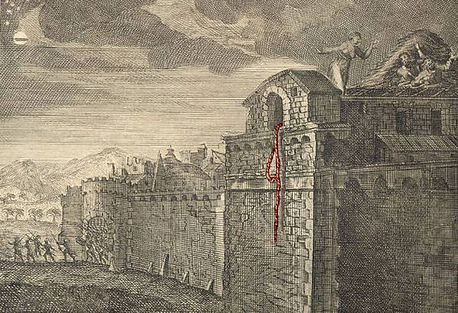
Faithful Living. . . .Fearless Leading
Joshua 2
Rahab and the Spies

Slide 2
Read Joshua 2:1-24
Then in groups of 3-4:
What are some observations that stand
out from this chapter regarding. . .
The Two Spies
Rahab
The Reputation of God (vs.8-11)

Slide 3
Joshua 2
Quiz
1. Where was Joshua when he sent the spies?
-Salem
-El-bethel
-Shittim
-Shechem
2. How many spies did Joshua send?
-3
-2
-12
-5

Slide 4
Joshua 2
Quiz
3. According to the report given to the king of Jericho, what time did the spies enter the city?
-In the afternoon
-At dawn
-In the night
-At daybreak
4. How would the invading Israelites
identify Rahab's house?
-A scarlet thread hanging from her ceiling.
-The color of her door.
-A scarlet thread hanging from her window
-A cord hanging from her window

Slide 5
Joshua 2
Quiz
5. For how long were the spies advised to hide before heading home?
-5 days
-3 days
-4 days
-1 day
6. Where did Rahab advise the spies to go and hide for some time before heading home?
-Up in the hills
-On the mountain
-At the rear side of Jericho
-Chinandega, Nicaragua

Slide 6
Joshua 2
Quiz
7. What did Rahab ask in return for the kindness she showed to the spies?
-She asked the spies to come back for her before the fall of Jericho.
-She asked the spies to remember her to Joshua.
-She asked for pieces of silver from the spies.
-She asked for her life and those of her family to be spared when the Israelites come to take Jericho.

Slide 7
Joshua 2
Quiz
8. The kings whom the Israelites defeated were from which nation?
-They were Amorites
-They were Hittites
-They were Hivites
-They were Chaldeans
9. Before Israel planned to capture Jericho,
which kings had they already defeated?
-Balak and Og
-Sihon and Og
-Adoni Bezech and Og
-Adoni Bezech and Sihon

Slide 8
Joshua 2
Quiz
10. How did Rahab hide the spies?
-She hid them among sacks of wheat.
-She hid them among planks of wood.
-She hid them among stalks of flax.
-She hid them among sacks of corn.

Slide 9

8 Life Leadership Lessons from Joshua 2:1-24
Lesson # 1 –Somethings are best kept secret (2:1)
“secretly sent”
Joshua decided to send the spies into Jericho secretly without public knowledge. Why is this important?

Slide 10
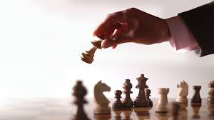
8 Life Leadership Lessons from Joshua 2:1-24
Lesson # 2 - Be specific and strategic – 2:1 “especially Jericho”
Jericho was the first city, and the first obstacle for Israel which needed to be dealt with. Tackle one obstacle at a time. Don’t get ahead of yourself.

Slide 11
8 Life Leadership Lessons from Joshua 2:1-24
Lesson # 3 - Don’t have to many cooks in the kitchen.
Joshua only selected 2 men to scout out Jericho. Moses selected 12 men in Numbers 13.
Major decisions for your ministry, family, or business can easily get stalled, or sidetracked if too many people have a say.

Slide 12
8 Life Leadership Lessons from Joshua 2:1-24
Lesson # 4 - Don’t delay but also don’t rush forward in making a quick decision. (2:16)
Discern between forcing a decision and making a calculated decision. Is God really in this?

Slide 13
8 Life Leadership Lessons from Joshua 2:1-24
Lesson # 5 - What’s the word on the street?
If God is in this, nothing will stop it! (Acts 5:39)
. . .the two spies stayed at Rahab’s house, and she went into great detail of how afraid the people were of the Israelites because of the power and might of their God. Vs.9-11

Slide 14

8 Life Leadership Lessons from Joshua 2:1-24
Lesson #6 - Don’t gossip, go straight to the leader.
When Joshua’s men returned, they went straight to Joshua to give their report. vs.23
Share a time in ministry where
instead of someone going to the person
they had a problem with, they went to
several other people instead.

Slide 15
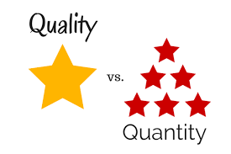
8 Life Leadership Lessons from Joshua 2:1-24
Lesson #7 – Seek quality people not quantity people.
Pick high quality, godly, trustworthy men who are available, faithful, teachable.
Take your time to select high quality people.

Slide 16
8 Life Leadership Lessons from Joshua 2:1-24
Lesson #8 – Be a Leader of your word. (2:12-21)
Some will follow your lead because of your title, but many will follow because you will do what you say you will do.

Slide 17
