Slide 1

Faithful Living…..Fearless Leading
Joshua 7:1-26
The Thrill of Victory and the
Agony of Defeat

Slide 2


Slide 3

Observations on Joshua 7:1-26
Asks the question: What do I see in the passage that stands out? Look for key words, phrases, comparisons or contrasts. Questions like – Who? What? Where? When? How? and Why?
Observation teaches us to see exactly what the passage says. It is the basis for accurate interpretation and correct application.

Slide 4
Israel has had a series of incredible victories.
The thrill of victory = Crossing the River Jordan
The thrill of victory = Building a memorial for future
generations at Gilgal.
The thrill of victory = Defeating the city of Jericho
“But” – 7:1 ((a word that contrasts Israel’s obedience in relying and defeating Jericho, to their disobedience and taking the devoted things.)

Slide 5
Terms that need explained:
The devoted things - Mentioned twice in verse 1. Also, recorded in verse 11, 12, 13. NKJV – accursed – Joshua 6:17-19, 21
When the children of Israel were told by God to take the city of Jericho, they were given a strict warning. When you take the city of Jericho, do not to touch the things within the city, with the exception of the silver, gold, and bronze which was to go into the treasury of the Lord. Everything else including man, woman, and child were to be killed.(Exception – Rahab and her family.) Nothing in the city was to be touched or taken because it was all considered devoted.

Slide 6
Terms that need explained:
Trespass - To act covertly or to cover up. A willful offense against God by covering or hiding our sin against God.
God told the people not to do something, and one individual did not listen and literally covered it up and it became a secret sin.
Read – verses 3-9
How does Joshua respond when he hears Israel has been defeated and has lost 36 men?

Slide 7
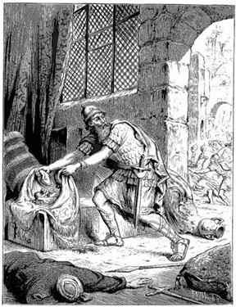
How does God respond
to Joshua in verses 10-15?

Slide 8
The Confession and Consequences of Achans’ Sin
7:16-26
The confession of Achan:
I saw I coveted I took
I hide
Parallels in Genesis 3:1-13

Slide 9
Sin will take you further you want to go
Keep you longer than you want to stay
Cost you more than you want to pay.
“You can be sure of this; your sin will find you out.”
Numbers 32:23
Just because Achan confessed his sin, does not mean he (we) will escape the consequences for his (our) sin.

Slide 10
The Confession and Consequences of Achans’ Sin
7:16-26
The Consequences of Achan’s sin:
The devoted things are found in Achan’s tent.
The devoted things are placed in front of all Israel
The whole family is brought to the Valley of Achor (valley of trouble.)

Slide 11
The Confession and Consequences of Achans’ Sin
7:16-26
Achan and his family and livestock are destroyed. (vs.25)
The sinful actions of one person can affect the lives of those around us.
In Groups 3-4 – what are some Biblical Leadership Principles you see by looking at Israels’ defeat against Ai?

Slide 12
Leadership Reminders from the sin of Achan
1. A good leader welcomes accountability and provides accountability.
2. A good leader asks the hard questions.
3. A good leader will not ignore hidden sin personally or corporately. Myth – I can hide my sin and get away with it. (Numbers 32:23)

Slide 13
Leadership Reminders from the sin of Achan
4. A good leader does not cut corners (morally, ethically, spiritual) in their personal and private life.
5. A good leader will address issues within a group before they become larger problems (vs.23)
6. Sin in the body should stir a healthy fear in us to draw nearer to God.

