Slide 1

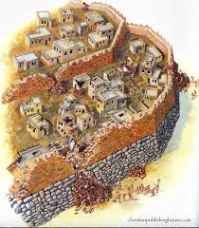
The Fall of Jericho
Joshua 6

Slide 2
Shout! For the Lord has given you the city.
Joshua 6:16

Slide 3
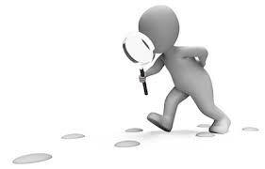
Observation:
Read Joshua 6
What are key words/phrases that stand out
in the chapter?

Slide 4
Key words/phrases –
-Gilgal (base camp) (2-3 miles from Jericho) 1:11,14
-Seven priests, seven trumpets, seventh day, seven times (vs.3-4)
You shall march around the city, all the men of war going
around the city once. Thus shall you do for six days. Seven priests shall bear seven trumpets of rams' horns before the ark.
On the seventh day you shall march around the city seven times, and the priests shall blow the trumpets.

Slide 5
Action words –
March or walk(ing) - 6:3,4,7,9,13,14,15
Take up – vs.6
Blew – vs.8
Shout – vs.10
Took up – vs.12-13
Brought out – vs.23

Slide 6
God’s divine reputation goes before the
people of Israel
Now Jericho was shut up inside and outside because of the people of Israel. None went out, and none came in. Joshua 6:1
As soon as all the kings of the Amorites who were beyond the Jordan to the west, and all the kings of the Canaanites who were by the sea, heard that the Lord had dried up the waters of the Jordan for the people of Israel until they had crossed over, their hearts melted and there was no longer any spirit in them because of the people of Israel. Joshua 5:1

Slide 7
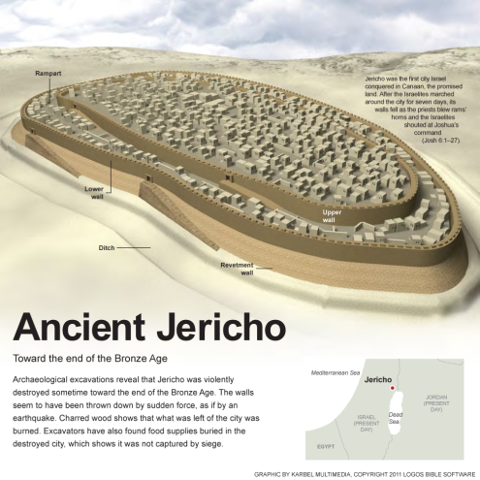
City of Jericho – around 10 acres, with approximately 2,000 people who lived in the city.
The outer wall was 6 feet thick and 20 feet high. The inner wall was 12 feet thick and 30 feet high. Between these walls was a 15-foot guarded walkway.

Slide 8
Joshua 6:8-9, 12-14
Armed men in front
7 priests with rams' horns
Priests carrying the Ark of the covenant
Rear guard and the people.
2. God’s Divine Instructions

Slide 9
How did an enemy try to attack a city?
-Starvation and cut off water supply
-Tunneling under the wall
-Fire
-Battering Ram (knocking down walls and gates)
-Ambush
-Manipulation – trying to persuade someone within the city to let them in.
-Building a mound against a city wall so that attacking soldiers could climb over the wall.

Slide 10
3. The Rescue of Rahab – Joshua 6:15-17,22-23
On the seventh day they rose early, at the dawn of day, and marched around the city in the same manner seven times. It was only on that day that they marched around the city seven times. And at the seventh time, when the priests had blown the trumpets, Joshua said to the people, “Shout, for the Lord has given you the city. And the city and all that is within it shall be devoted to the Lord for destruction. Only Rahab the prostitute and all who are with her in her house shall live, because she hid the messengers whom we sent.

Slide 11
4. Things devoted to destruction –vs. 21,24
²¹ Then they devoted all in the city to destruction, both men and women, young and old, oxen, sheep, and donkeys, with the edge of the sword.
²⁴ And they burned the city with fire, and everything in it. Only the silver and gold, and the vessels of bronze and of iron, they put into the treasury of the house of the Lord.

Slide 12
5. A future curse on the city of Jericho- vs.26
Joshua laid an oath on them at that time, saying, “Cursed before the Lord be the man who rises up and rebuilds this city, Jericho.
“At the cost of his firstborn shall he
lay its foundation,
and at the cost of his youngest son
shall he set up its gates.”
(500 years later - 1 Kings 16:34)

Slide 13
When Facing Your Personal Jericho’s
What might be too hard for you is never too hard for God.
Battles are best fought with prayer and faith.
3.Keep your eyes on the Lord .
4. Be silent and get ready to shout.

