Slide 1

Faithful Living…..Fearless Leading
Joshua 5:13-15
BATTLE READY

Slide 2
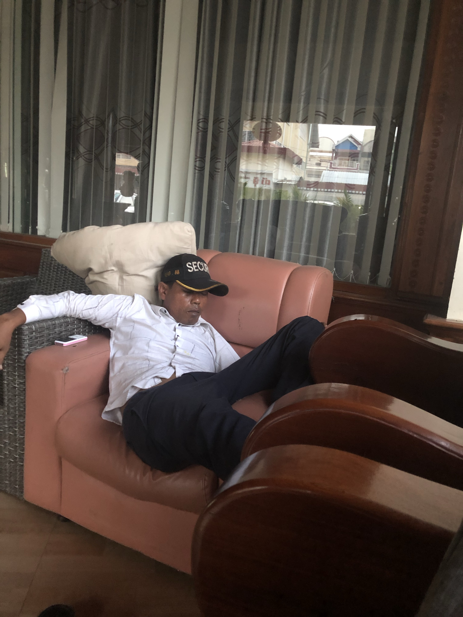
ARE YOU BATTLE READY?

Slide 3
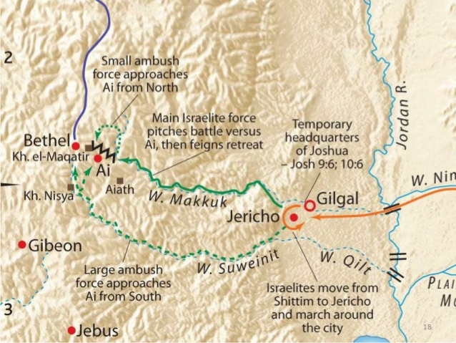
How do you prepare to meet your competition?

Slide 4
The Fear of the Canaanites (5:1)
Circumcision at Gilgal (5:2-9)
The First Passover in Canaan (5:10-12)

Slide 5
Joshua was by Jericho, he lifted up his eyes and looked, and behold, a man was standing before him with his
drawn sword in his hand. And Joshua went to him and said to him, “Are you for us, or for our adversaries?”
And he said, “No; but I am the commander of the army of the Lord. Now I have come.”

Slide 6
And Joshua fell on his face to the earth and worshiped
and said to him, “What does my lord say to his servant?”
And the commander of the Lord's army said to Joshua, “Take off your sandals from your feet, for the
place where you are standing is holy.”
And Joshua did so. Joshua 5:13-15

Slide 7
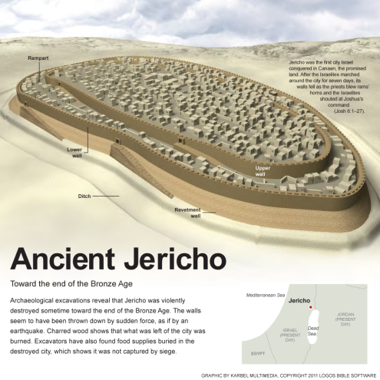

Slide 8
Christophany
A pre-incarnate appearance of Jesus Christ in
human form. A pre-nativity appearance of God in the flesh.

Slide 9
3 leadership reminders
1. It’s not a question of “Lord, will you join us?” It’s a question of will we join Him?
2. Every leader will face some kind of Jericho in life.
3. A responsible person realizes he cannot defeat his Jericho's alone.

Slide 10
…..Apart from me you can do nothing.
John 15:5
Are you ready to face the Jericho’s that will come your way as a church?
Only when we submit to God’s battle plan will we
be Battle Ready to face our Jericho’s.

Slide 11
In groups of 3 discuss what might be some Jericho’s
you are facing in your ministry?
Spend time praying for each other.

