Slide 1

Faithful Living…..Fearless Leading
Joshua 4:1-24
Living Memorials

Slide 2
Nostalgia - a feeling of pleasure and sometimes slight
sadness when thinking about the past, which can be triggered
by various things.
Music Pictures
Places Objects
Smells Movies
Food Events

Slide 3

What memories do you cling to which have strengthened your faith over the years?

Slide 4
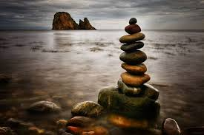
Key words or phrases
Jordan – 17 times
Joshua – 12 times
Passing over– 9 times
Stone(s) – 8 times
Ark – 6 times

Slide 5
Growing Deeper:
What stands out to you as important in verses 1-7?
What stands out to you as important in verses 8-14?
What stands out to you as important in verses 15-24?

Slide 6
Looking back…….looking forward
1. The stones were not designed to keep them locked in the past but to prepare, equip, and encourage them for the future!
The memories of our past can impact our present.
2. These stones or memorials where a reminder to future generations of all that God had accomplished .

Slide 7
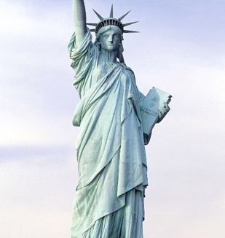

Statue of Liberty

Slide 8
These stones or memorials would be a visible proclamation of the living God to a lost world vs. 24
He did this so that all the peoples of the earth might know that the hand of the Lord is powerful and so that you might always fear the Lord your God. Josh. 4:24

Slide 9
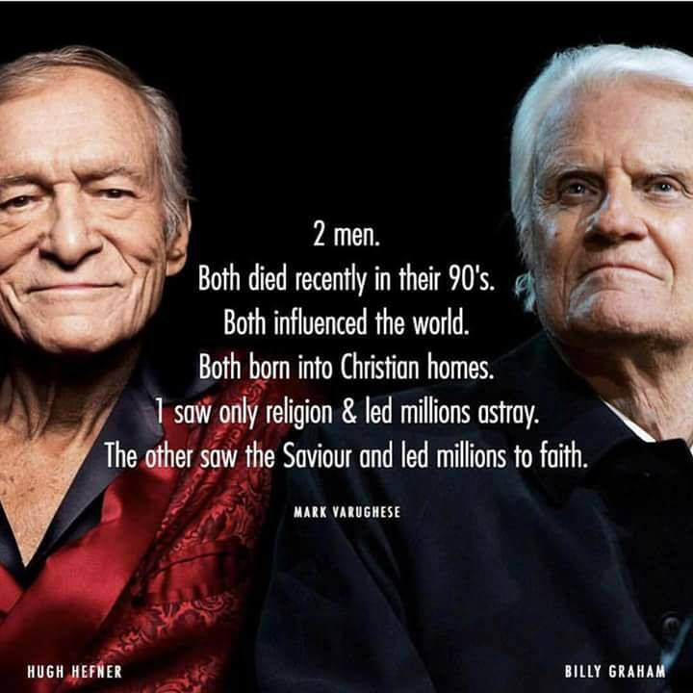
Will you leave a positive legacy or a negative one to those who come after you?
What will your children and church remember most about you?

Slide 10
12 stones set up in the River Jordan (4:9)
12 stones set up at Gilgal (4:19)
Meaning of Gilgal - means "circle" or "rolling away" and refers to a place near Jericho where the Israelites first encamped after crossing the Jordan, marking their transition from slavery to freedom and the start of their conquest of Canaan.
Distance from Jordan to Gilgal- 17 kilometers (10.5 miles)

Slide 11
The challenge for our church and our children
- Provide visible signs and stories to your children and church of where God has or is working .
Living stones stand out for us when God showed up, changed our direction and gave us hope.
We can go through life and miss leaving living memorials behind.

Slide 12
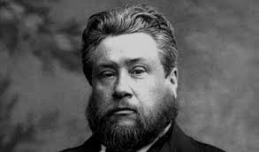
Are you a living memorial of generosity, gratitude, and grace to your church and family?
Be a living stone of the power of God’s Word and prayer to present and future generations.
Monumental moments stand
out at times in our life,
when God showed up,
changed our direction, and gave
us hope.

