Slide 1
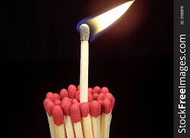
Avoiding Ministry
Burnout

Slide 3
How would you define
ministry burnout?
“Ministry would be so much more enjoyable if it didn’t involve people.”
Confession of a burned-out pastor

Slide 4
Symptoms of Ministry Burnout
Denial of burnout
Tired emotionally and physically – even insomnia
Anxiety Overload
Emotional outbursts of anger, crying, apathy
Hidden addictions
Desire to retreat or isolate
You question your calling

Slide 5
In Groups….
Recall a time in the past or even the present that you experienced any of these warning signs? Share your story with the person beside you.

Slide 6
Prevention and treatment of ministry burnout
Exodus 18:1-12

Slide 7
# 1 We all need a Jethro in our life
# 2 Reflect on God’s consistent POWER, PRESENCE, PROVISION AND PROTECTION
# 3 Worship – Word - Wait

Slide 8
What does Jethro see happening to Moses which will eventually lead to burnout?
Verses 13-18

Slide 9
What advise does Jethro give to Moses as a leader? Verses 19-24

Slide 10
How to treat ministry burnout from happening
Delegate
Ask yourself, “Do I have time to think, rest, heal, play?”
Take time off. Your ministry does not rest only on you.

Slide 11
How to treat ministry burnout from happening
I had to ask myself, “What is my identity in?”
Find something of value to do outside of ministry.

