Slide 1
The Doctrine of God
Lesson Overview:
The Existence of God
The Attributes of God
The Trinity of God

Slide 2
THE EXISTENCE OF GOD:
How would you help someone who doubts the existence of God to truly see there is a living God whom we can know personally?
How do we know God exists?
For ever since the world was created, people have seen the earth and sky. Through everything God made, they can clearly see his invisible qualities—his eternal power and divine nature. So, they have no excuse for not knowing God. Romans 1:20

Slide 3
Man’s conscious gives evidence of the existence of God.
The Word of God gives evidence of the existence of God.
Creation shows evidence of the existence of God.
History, literature, and archaeology support the existence of God.
Personal experiences support the existence of God.
Romans 1:18-20; Psalm 14:1; 19:1; John 5:39-40; Luke 16:19-31; James 2:19

Slide 4
THE LAW implies a Lawgiver
RULE implies a Ruler
DESIGN implies a Designer
COMMAND implies a Commander
CREATION implies a Creator

Slide 5
THE ATTRIBUTES OF GOD
Is it possible to know who God is, and what He is like?
How do we describe God?

Slide 6
The Attributes of God are divided up into two categories:
1. “Non-communicable Attributes” (qualities possessed by God alone)
2. “Communicable Attributes” (qualities that both God and we possess, such as love, goodness, purity, mercy, and faithfulness).

Slide 7
NON-COMMUNICABLE ATTRIBUTES OF GOD:
Because God is infinite…..He has no limits or boundaries.
Psalm 145:3; Romans 11:33
Because God is self-existent…..He has no beginning and no end. Psalm 90:2; Acts 17:24
Because God is eternal…..He is not bound by the dimension of time. Psalm 102:12; 106:1

Slide 8
NON-COMMUNICABLE ATTRIBUTES OF GOD:
Because God is self-sufficient…..He has no need for anything.
Because God is all-powerful…..He can help me with anything. Psalm 147:5; Job 42:1-2; Jer. 32:17
Because God is present everywhere…..He is always with me. Col. 1:17; Prov. 15:3; Psalm 139:7-12; Hebrews 4:13

Slide 9
NON-COMMUNICABLE ATTRIBUTES OF GOD:
Because God is all-knowing…..I will go to Him with all my questions and concerns. Psalm 139:4; Jer. 29:11; Daniel 2:21
Because God is Sovereign…..I will joyfully submit to His will. Daniel 4:35; Job 12:10-25

Slide 10
COMMUNICABLE ATTRIBUTES OF GOD:
(qualities that both God and we possess, here are just a few)
Because God is Holy…..I will devote myself to Him in purity, worship, and service. 1 Peter 1:14-15
Because God is Love….He is unconditionally committed to my well-being. Romans 8:35-39

Slide 11
COMMUNICABLE ATTRIBUTES OF GOD:
(qualities that both God and we possess, here are just a few)
Because God is merciful…..He forgives me of my sins when I sincerely confess them. Psalm 51: 1 John 1:9
Because God is faithful…..I will trust Him to always keep His promises. 1 Cor. 10:13; 2 Timothy 2:13

Slide 12
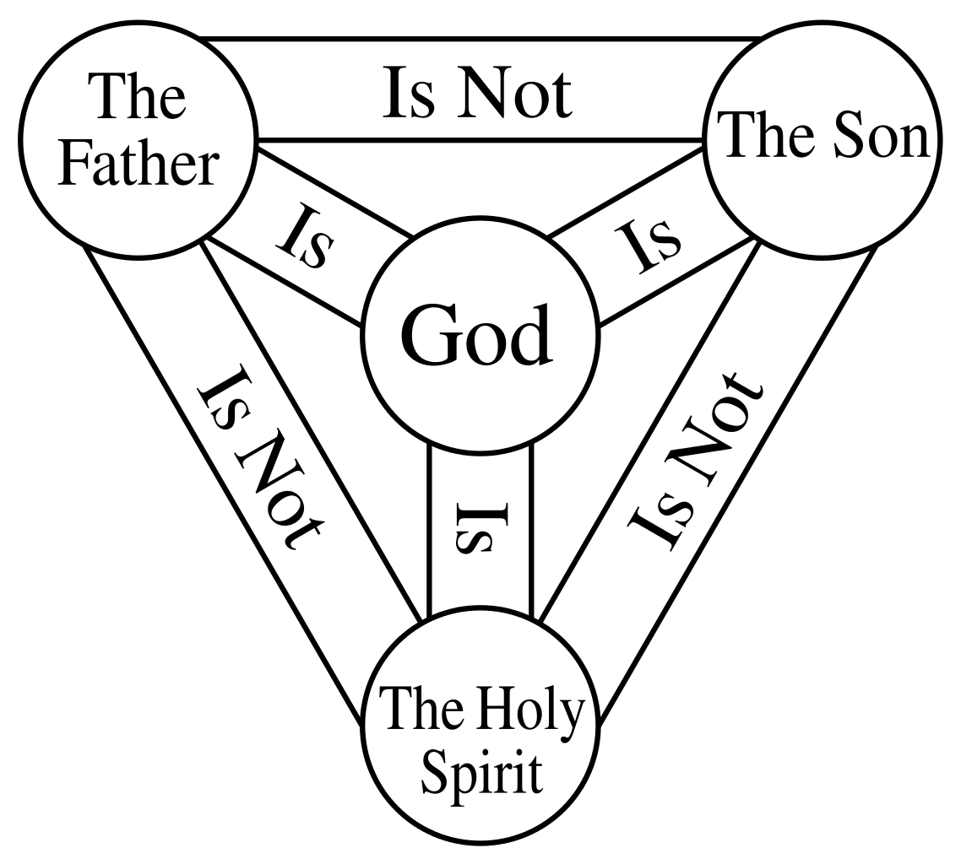
THE TRINITY OF GOD
Hear, O Israel! The Lord is our God,
the Lord is one! Duet. 6:4
The grace of the Lord Jesus Christ, and the love of God, and the fellowship of the Holy Spirit, be with you all.
2 Corinthians 13:14; John 14:15-17; Matthew 28:18-20

