Slide 1
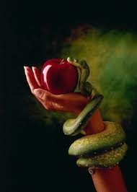
The Doctrine of Sin
Session 1

Slide 2
What is Doctrine?
Doctrine is a set of beliefs that complement or match the authority and principles of God’s Word (2 Timothy 3:16-17; 2 Peter 1:20-21), in order that the church body can function in unity and purpose for the glory of God.

Slide 3
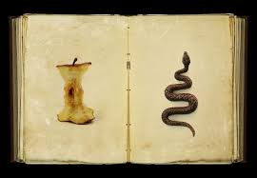
Lesson Overview
The Definition of Sin
The Existence of Sin
The Extent of Sin
The Consequences of Sin

Slide 4
The Definition of Sin
Sin is described in the Bible as a transgression or a violation of the perfect holiness and character of God (1 John 3:4). Rebellion against God (Deuteronomy 9:7; Joshua 1:18).
To miss the mark of the law of God and righteousness of God.

Slide 5
The Definition of Sin
Sin is falling short of the ultimate goal of obeying God’s directives from His Word (Romans 3:23 & Is.53:6).

Slide 6
Misunderstanding of Sin
Misunderstanding # 1 – Sin is an illusion.
Misunderstanding # 2 – Sin is selfishness. Though this may be true, selfishness is a result of our sin. But sin at its core is to be opposed to God and His Word.

Slide 7
Misunderstanding of Sin
Misunderstanding # 3 – I can live a life of sin and still have fellowship with Christ (1 John 1:6).
Misunderstanding # 4 – I have not sinned. (1 John 1:8 &10; Romans 3:23).
Misunderstanding # 5 - There are no consequences to our sinfulness (Romans 6:23; Numbers 32:23).

Slide 8
The Existence of Sin
Sin or evil did not originate with God.
Then God said, “Let us make man in our (Trinity) image, after our (Trinity) likeness…..so God created man in His own image, in the image of God He created him; male and female He created them. Genesis 1:26-27

Slide 9
The Existence of Sin
And God saw everything that He made and behold, it was very good. Genesis 1:31

Slide 10
The Existence of Sin
Evil in the World originated with Satan.
“How you are fallen from heaven, O shining star, son of the morning! You have been thrown down to the earth, you who destroyed the nations of the world. ¹³ For you said to yourself, ‘I will ascend to heaven and set my throne above God’s stars. I will preside on the mountain of the gods far away in the north. ¹⁴ I will climb to the highest heavens and be like the Most High.’ Isaiah 14:12-14

Slide 11
All of humanity has rebelled against our Creator. Romans 3:10.
Mankind seeks to worship the created rather
than the Creator. Romans 1:25

Slide 12
We love ourselves and the things of man rather than the heart of a loving God. 2 Timothy 3:1-4
We obey our flesh rather than obeying His righteous law and character. “Those controlled by the flesh cannot please God.” (Romans 8:8)
Against You, and You alone, have I sinned. Psalm 51:4

Slide 13
Most people will acknowledge that there is something wrong in our world….. Question: Give an example of how you have seen the existence of sin in our world today? Does this trouble you? In what way?

Slide 14
We can divide the types of sins into 2 main categories
Sins of Commission – Sins of commission are sins that we commit by doing something we shouldn’t do.

Slide 15
We can divide the types of sins into 2 main categories
Sins of Omission - Sins of omission are sins we commit by not doing something we should do. This is a sin that is easy to hide from others.

Slide 16
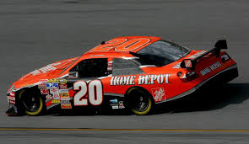
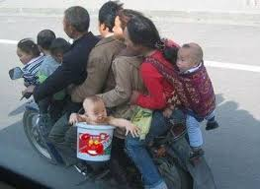
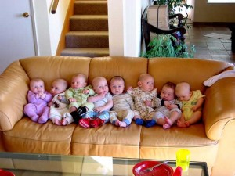
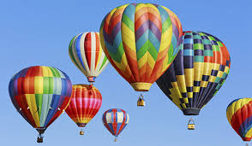
What are some observations you can make about these pictures?

Slide 17
The Existence of Sin
Evil originated with the fall.
Genesis 3:1-13
Read the Passage to yourself –
Someone read it out loud –

Slide 18
The Existence of Sin
Observation – What do you see? What does it say?
Key words, phrases, people or characters in the passage. Repeated words.
Who? What? Where? When? How? Why? ”Therefore” or “But”

