Slide 1
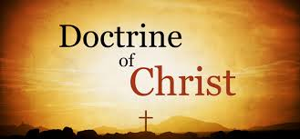
The Doctrine of Jesus Christ – Divinity (Part 1)

Slide 2
What is Doctrine?
Doctrine is a set of beliefs that complement or match the authority and principles of God’s Word (2 Timothy 3:16-17; 2 Peter 1:20-21) in order that the church body can function in unity and purpose for the glory of God.

Slide 3
The Doctrine of Christ will be divided up into 4 major parts
Part 1 - The Divinity of Christ
Part 2 - The Humanity of Christ
Part 3 - The Resurrection of Christ
Part 4 - The Return of Christ

Slide 4
THE DIVINITY OF JESUS CHRIST
Question:
Who are you most like – your mother or father? How is your personality and character similar?

Slide 5
Was Jesus Truly God?
The Apostles address Jesus as God John describes Jesus as God - John 1:1-3
Thomas describes Jesus as God - John 20:27-28
Paul describes Jesus as God - Roman 9:5
Peter describes Jesus as God - 2 Peter 1:1

Slide 6
Jesus Himself Identifies Himself as God
He uses the same name as God – John 5:16-18; 8:58; Exodus 3:13-14
Question:
How did you get your name? Were you named after someone in your family or a famous person? Does your name affect how you want to live your life?

Slide 7
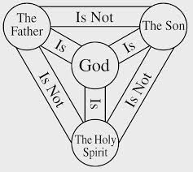
Jesus claims to be equal with God – John 1:33-34
Jesus and God the Father are One – John 10:30
Jesus is the exact image of God – Col. 2:9; Heb. 1:1-3

Slide 8
Jesus Pre-existence
Pre-existence is defined as “existence in a former state or previous to something else.” In the case of Jesus Christ, His pre-existence means that, before He became a man and walked upon the earth, He was already in existence as the second Person of the triune God. The Bible not only explicitly teaches this doctrine but also implies this fact at various points throughout the Gospels and Epistles. In addition, Jesus’ own actions reveal His pre-existence.
John 8:58
John 17:5
Col. 1:15-17
Heb. 10:5-7
Isaiah 9:6

Slide 9
“And He is the image of the invisible God, the first-born of all creation. Colossians 1:15 Question: "What does it mean that Jesus is the 'first-born' over Creation?” (see outline)

Slide 10
Jesus has attributes of God
He is eternal – Rev. 1:8; Col. 1:17
He is all powerful (Omnipotent) John 11:43-44; Matt. 28:18; Col. 2:10
Jesus is everywhere (Omnipresent) Matt. 18:20
Jesus is all knowing (Omniscient) Acts 1:24; 1 Cor. 4:5
He is Sovereign – Mark 2:5-7
He is worthy to be worshipped – Philippians 2:9-11

Slide 11
Question: Is the divinity of Jesus an easy or hard truth to accept? Why? What effect should this truth have on our lives and as a church?

Slide 12
Group Study – Colossians 1:15-20 Observation – Make a List How does Paul describe Christ? Interpretation – Ask a Question Ask a question about a word or an idea that you don’t understand. Application – Think of a Person Who is one person that can be impacted by your list?

