Slide 1
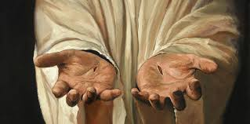
Doctrine of Jesus Christ (Part 2) Christ’s Humanity

Slide 2
That which was from the beginning, which we have heard, which we have seen with our eyes, which we looked upon and have touched with our hands, concerning the word of life. 1 John 1:1

Slide 3
Question: What one person in your life is most like you? A parent? A sibling? A child? A friend? In what ways are they like you? Do you talk about how similar you are?

Slide 4
Was Jesus truly human?
Jesus had a human body - Matthew 4:2-3; John 19:28
Jesus had a human mind - Luke 2:52
Jesus had human emotions - John 11:34-36; 12:27
Jesus was recognized as a man - Matthew 13:53-55

Slide 5
Question: Was there ever a time in your life when you felt like you were misunderstood or didn’t belong to the group of people around you? What were the circumstances? How did you feel?

Slide 6
The Virgin Birth:
The Bible teaches that Jesus was conceived in the womb of Mary by the miraculous work of the Holy Spirit, without a human father. The virgin birth made it possible for humanity and deity to unite in the person of Jesus. (See outline notes)

Slide 7
Why is it important that Jesus is human?
Jesus is our Substitute – Romans 5:6-8; 2 Corinthians 5:21
Jesus is our Representative – Romans 5:18-19
Jesus is our Mediator – 1 Timothy 2:5-6
Jesus is our Example – 2 Peter 2:21
Jesus is our Pattern – 1 Corinthians 14:42-44
Jesus is our Sympathizer – Hebrews 4:14-15

Slide 8
Question: How does the humanity of Jesus comfort us in times of sorrow, in times of temptation, or times of anger?

Slide 9
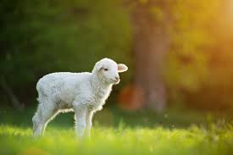
The Ministries of the God-Man (Jesus)
A. Jesus is our Savior (Romans 1:3-4). He came to die and set us free from the penalty of sin and death. He truly is the Lamb of God who takes away the sins of the world. (John 1:29, 36)

Slide 10
The Ministries of the God-Man (Jesus)
B. Jesus is our High Priest (Hebrews 4:14-16). Jesus intercedes for us and represents His people before the Father. Jesus is the one and only sinless sacrifice for the forgiveness of sin for all of mankind.

Slide 11
The Ministries of the God-Man (Jesus)
C. Jesus is our Judge (John 5:22). He is impartial and judges on the basis of His righteousness.
D. Jesus is the source of Christian living (1 John 2:6). He is our example to follow and empowers our lives.

Slide 12
Group Study
Observation – Make a List
How does John describe Christ? Make a list of all he says.
John 6:35-41 John 8:12
John 10:7-10 John 10:11-14
John 11:23-27 John 14:5-7
John 15:5-6

Slide 13
Interpretation – Ask a Question
What truth about Jesus is John trying to convey by including all these statements?
Application – Think of a Person
Who is one person that can be impacted by your list?

